Slide 1
Onomatopoeia
Onomatopoeia is when a word sounds like what it describes
Onomatopoeia is sometimes used in poetry
Listen to this song to see some examples: http://www.youtube.com/watch?v=f1b5kCvVBo8
© www.SaveTeachersSundays.com 2013

Slide 2
What sound can you hear?
Splash
Sound effect © www.freesfx.co.uk
© www.SaveTeachersSundays.com 2013
Images © www.clipart.com

Slide 3
What sound can you hear?
Whoosh
Sound effect © www.freesfx.co.uk
© www.SaveTeachersSundays.com 2013
Images © www.clipart.com

Slide 4
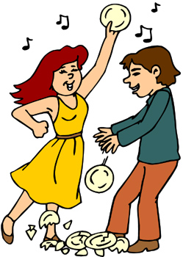
What sound can you hear?
Crash Smash
Sound effect © www.freesfx.co.uk
© www.SaveTeachersSundays.com 2013
Images © www.clipart.com

Slide 5
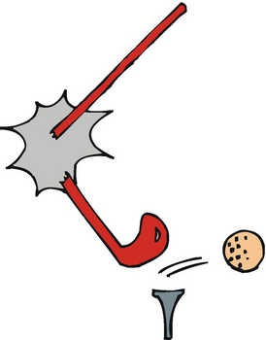
What sound can you hear?
Snap
Sound effect © www.freesfx.co.uk
© www.SaveTeachersSundays.com 2013
Images © www.clipart.com

Slide 6
What sound can you hear?
Buzz
Sound effect © www.freesfx.co.uk
© www.SaveTeachersSundays.com 2013
Images © www.clipart.com

Slide 7
What sound can you hear?
Hiss
Sound effect © www.freesfx.co.uk
© www.SaveTeachersSundays.com 2013
Images © www.clipart.com

Slide 8
What sound can you hear?
Sizzle
Sound effect © www.freesfx.co.uk
© www.SaveTeachersSundays.com 2013
Images © www.clipart.com

Slide 9
What sound can you hear?
Click
Sound effect © www.freesfx.co.uk
© www.SaveTeachersSundays.com 2013
Images © www.clipart.com

Slide 10
An onomatopoeic poem – The Break Down
Our poems are going to be about a car that breaks down.
What might each verse be about?
1st verse
The car breaks down
2nd verse
The owner gets angry when it won’t start
3rd verse
The owner attacks and smashes the car
What onomatopoeic words could we use?
Sound effect © www.freesfx.co.uk
© www.SaveTeachersSundays.com 2013
Images © www.clipart.com

Slide 11
1st verse - The car breaks down
clunk chug bang buzz clang
creak fizz hiss pop rattle
2nd verse -The owner gets angry when it won’t start
argh bawl beep groan moan
growl grunt honk mutter snarl
3rd verse - The owner attacks and smashes the car
bash bang boing boom clatter
ouch slash smack snap thump
Sound effect © www.freesfx.co.uk
© www.SaveTeachersSundays.com 2013
Images © www.clipart.com

